Slide 1
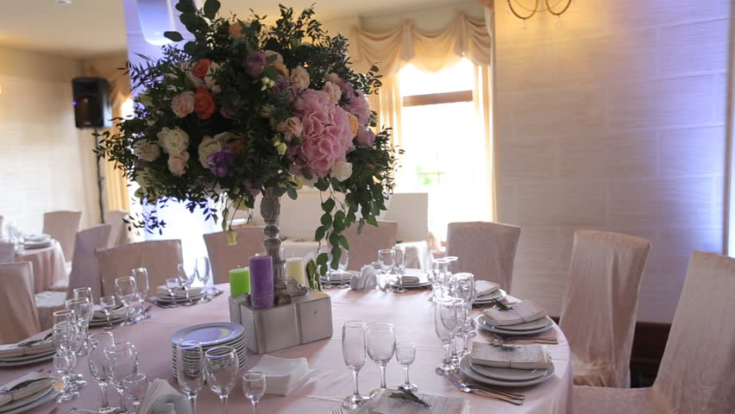
Unit 8

Slide 2
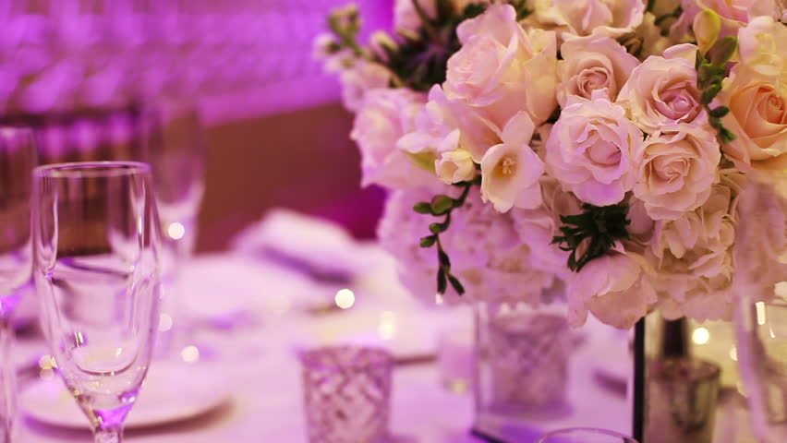
Opener

Slide 3
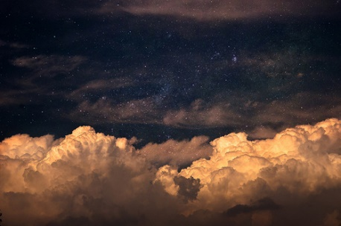
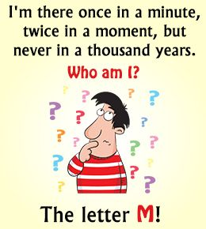
Solve this riddle!

Slide 4
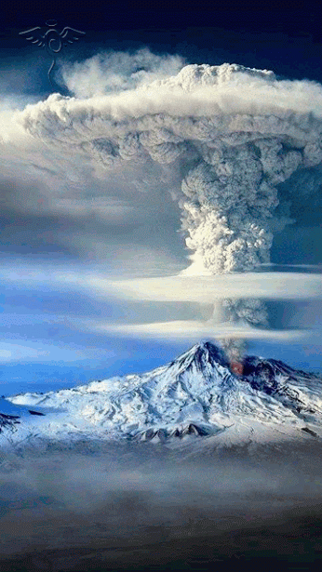
Student’s Book
Page 68

Slide 5
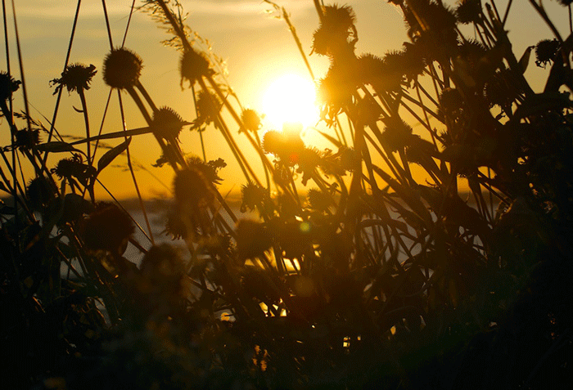
Writing

Slide 6

Writing
Group work

Slide 7
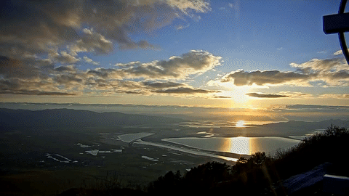

Your school is organising a writing competition entitled:
“The Development of Communication in the Future.”

Slide 8
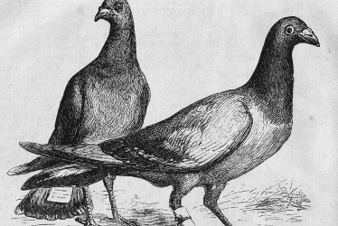
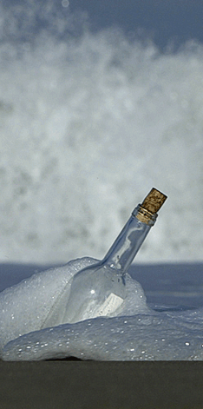
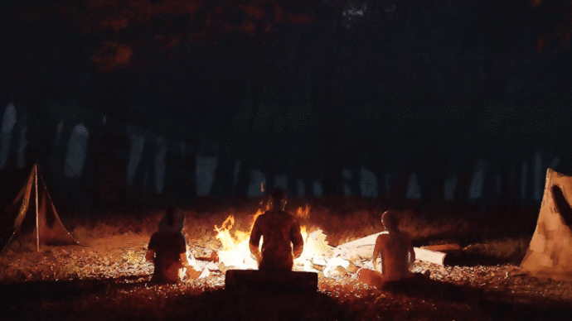
Plan and write a report of two paragraphs to take part in this competition.
1. In the 1st paragraph, write what means of
communication from the past you would like to bring back and why (messages in bottles, pigeons, smoke signals ..etc.)

Slide 9
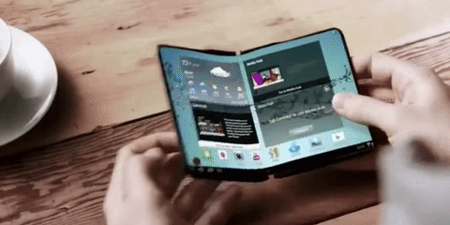
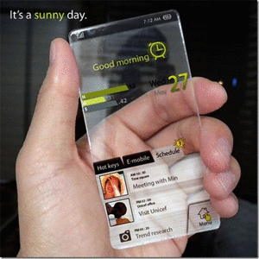
Plan and write a report of two paragraphs to take part in this competition.
2. In the 2nd paragraph, write about what you think communication will be like in the future.

Slide 10

3. Fill in the following organizer with your notes, then
write your report in your notebook.

Slide 11
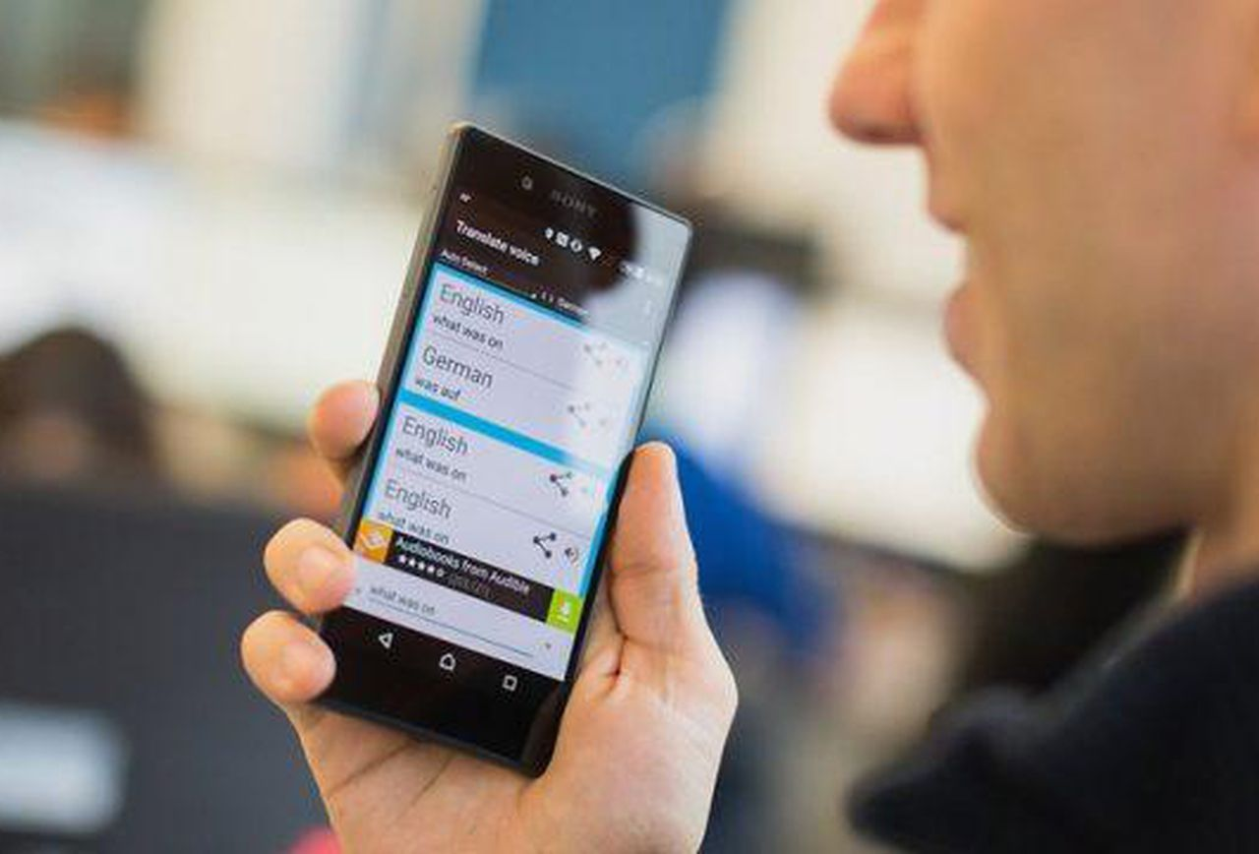
Read your organizers.

Slide 12
Fires and smoke signals
Wearable bracelet
Messengers
Smart newspaper
Fires
Smart eye lenses
Bottles
Auto voice translating
Pigeons
Flying cars
Telegraph
Household robots

Slide 13
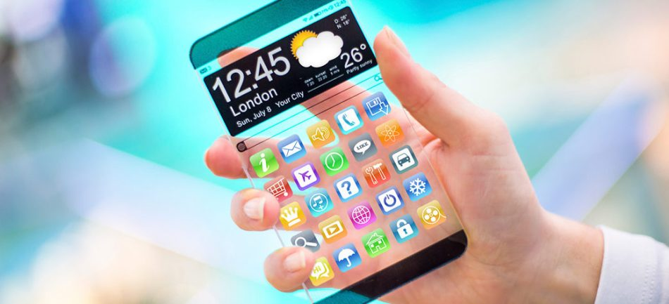
Revise your reports.

Slide 14
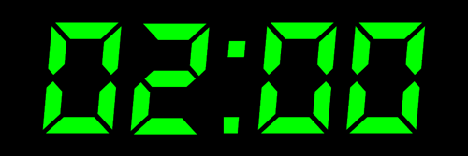

Checklist:
Did I include an Introduction that attracts the reader’s attention?
Did I make sure that each paragraph consists of a topic sentence and details that support the topic sentence? Did I end with a final thought stating my opinion?
Did I edit my writing?

Slide 15
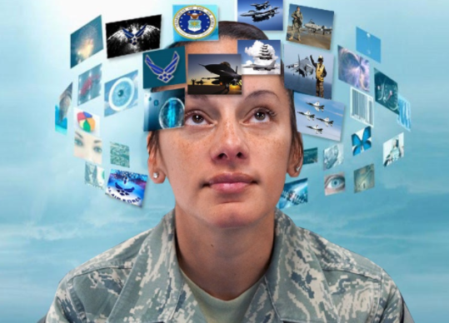
Read your reports.

Slide 16
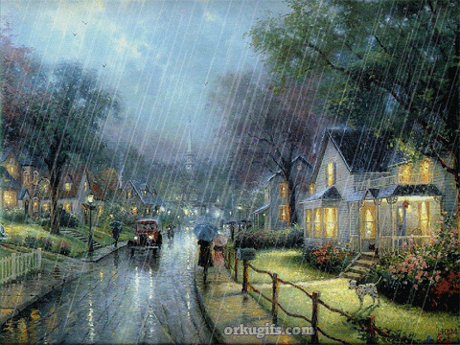
Workbook
Page 25

Slide 17
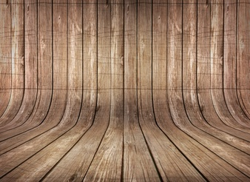
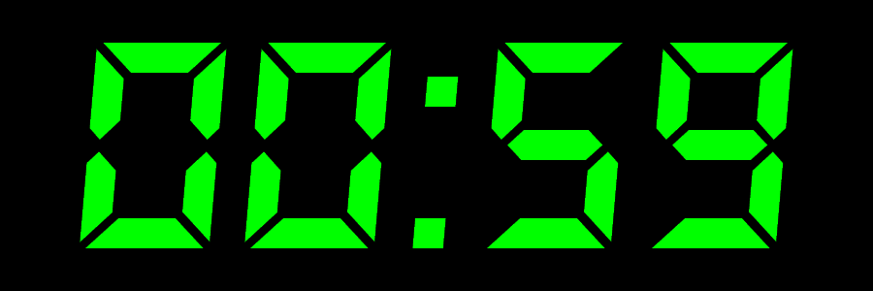


Slide 18

Check your answers.

Slide 19
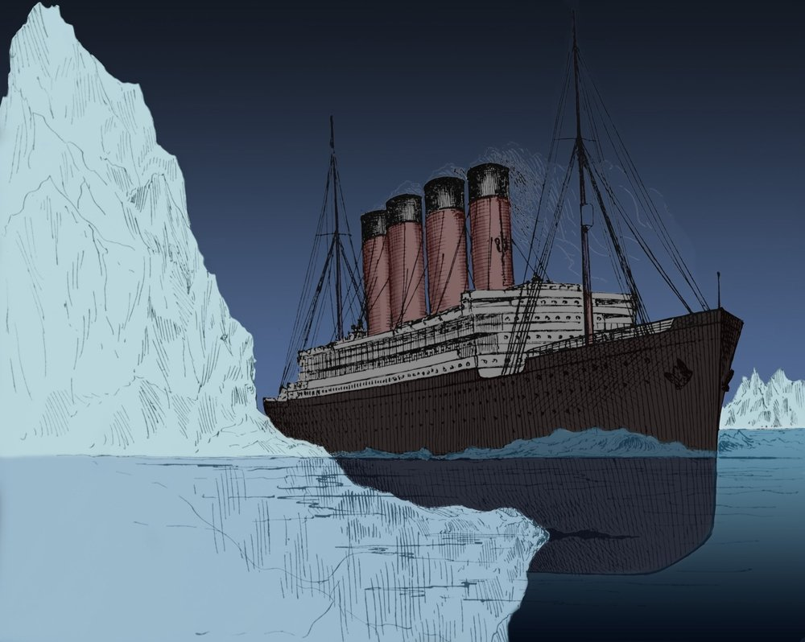
gradually various skillful carve consequently access
1. The captain of the ship is so ---------------- that he was able to avoid the iceberg.
skillful

Slide 20
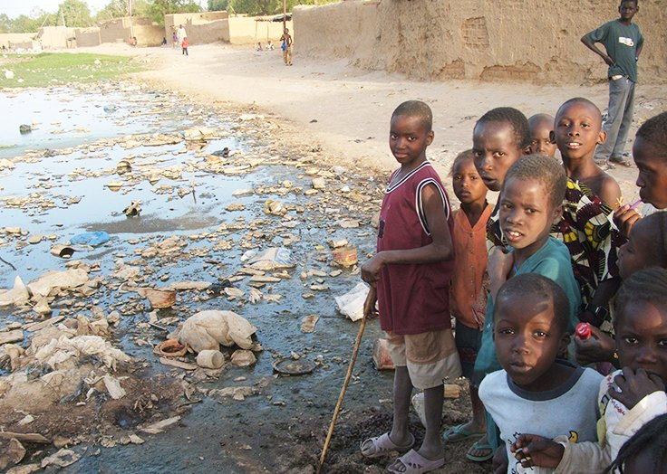
gradually various skillful carve consequently access
2. People in some poor countries are unable to get ---------------- to what they need.
access

Slide 21
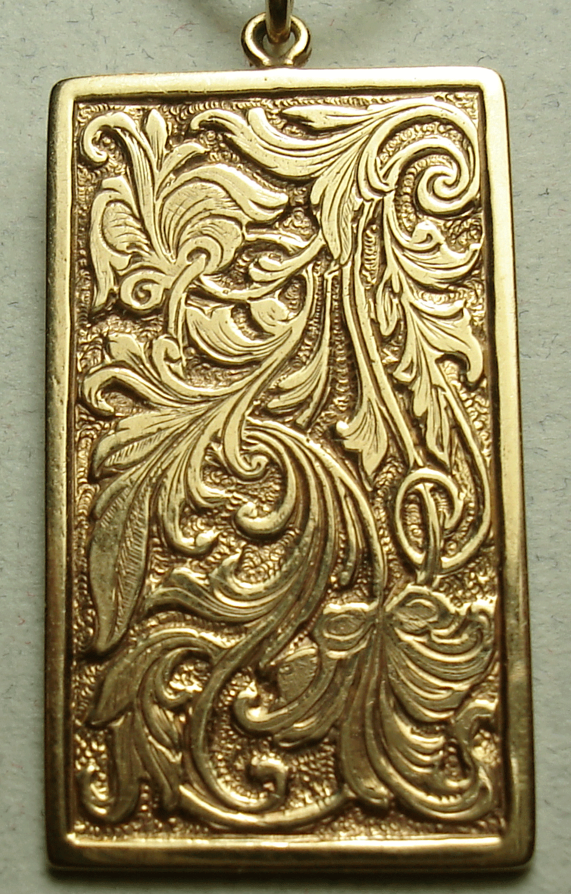
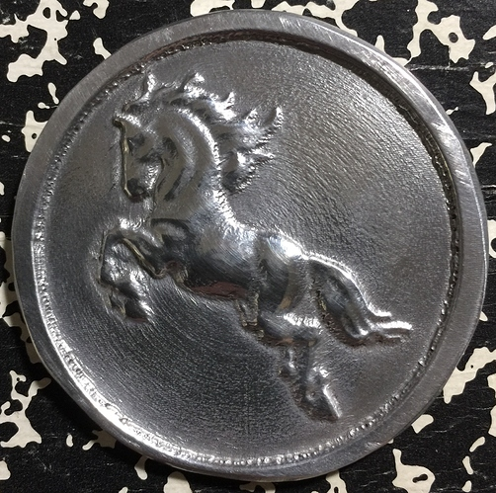
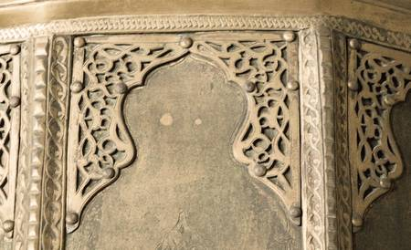
gradually various skillful carve consequently access
3. Only professional artists are able to
---------------- pictures on metals.
carve

Slide 22
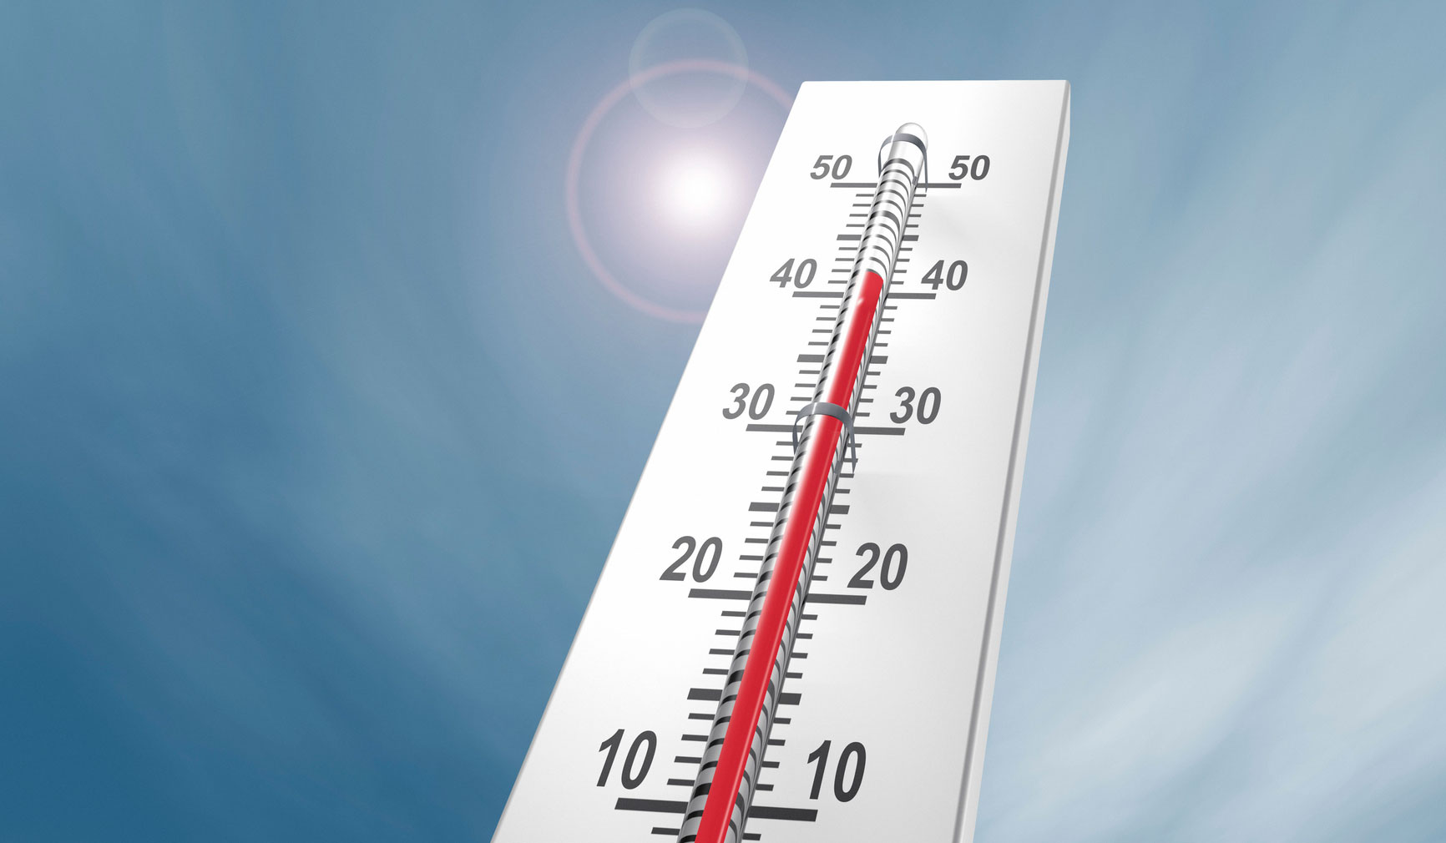
gradually various skillful carve consequently access
4. The weather is ------------------------ getting hotter these days.
gradually

Slide 23
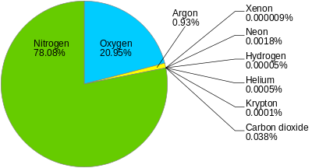
gradually various skillful carve consequently access
5. Air consists of ---------------- gases like Oxygen and Nitrogen.
various

Slide 24
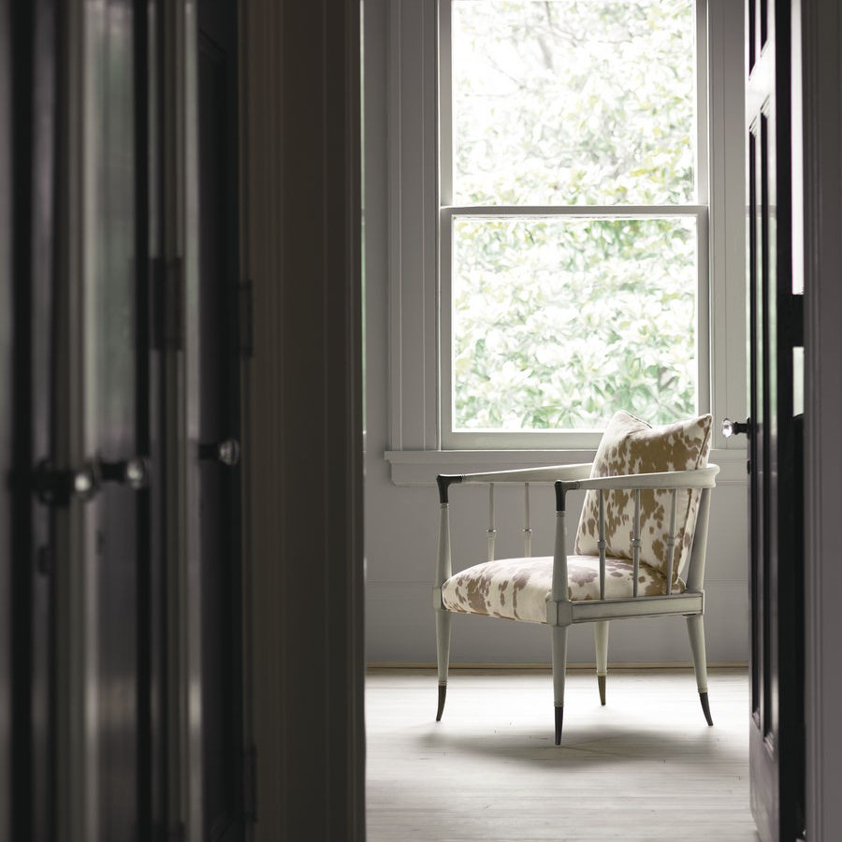
Workbook
Page 26

Slide 26
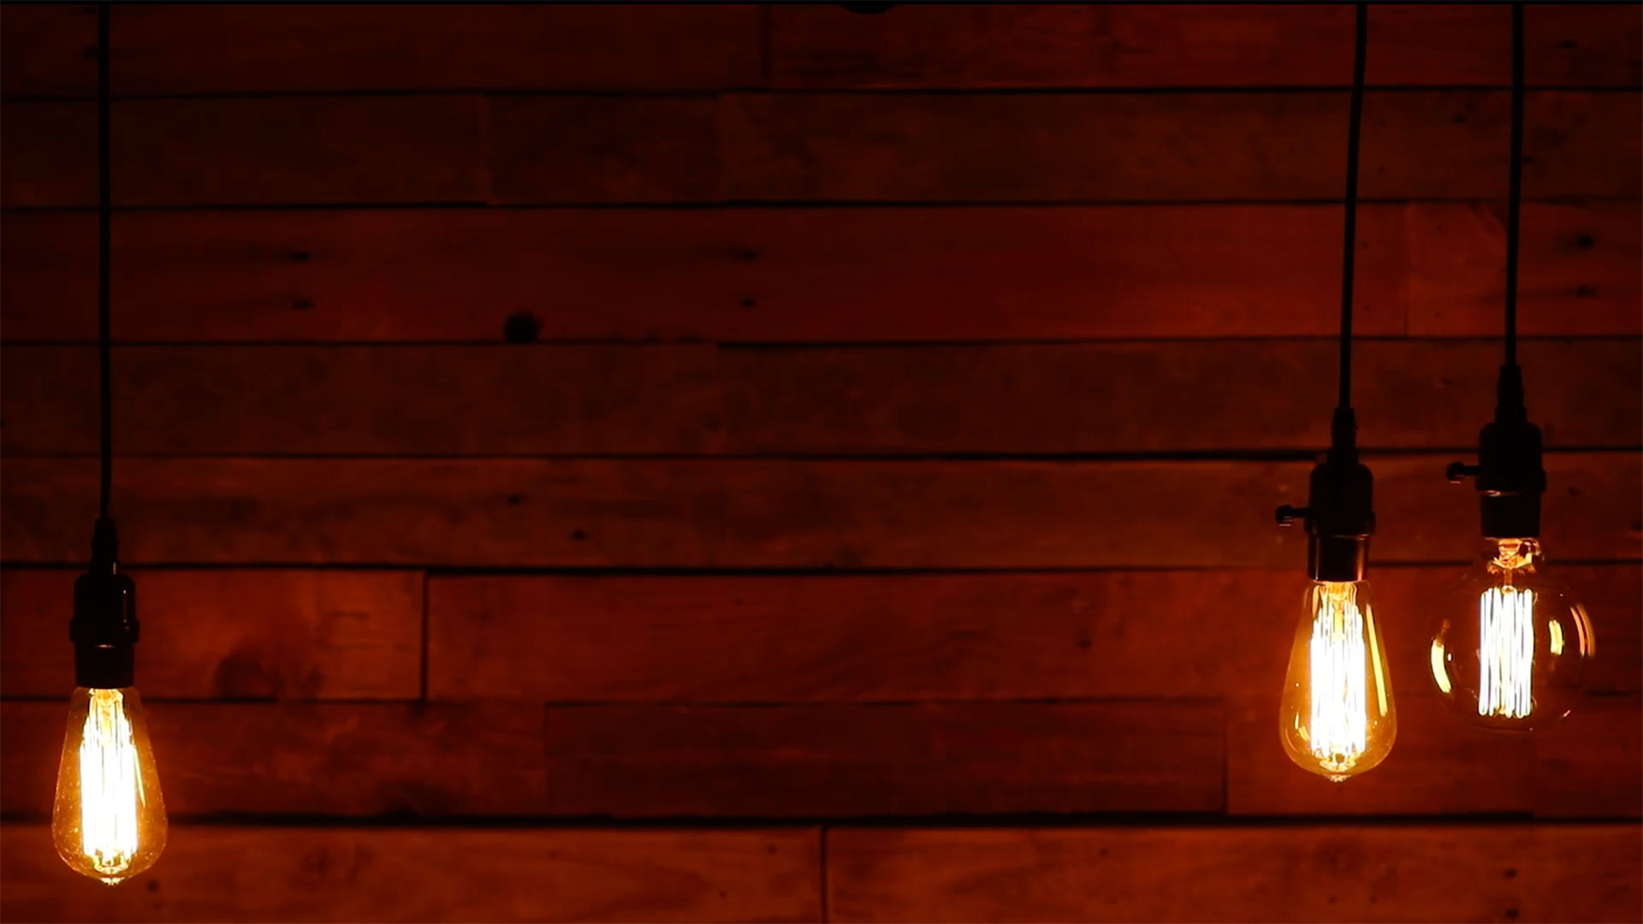
Check your answers.

Slide 27
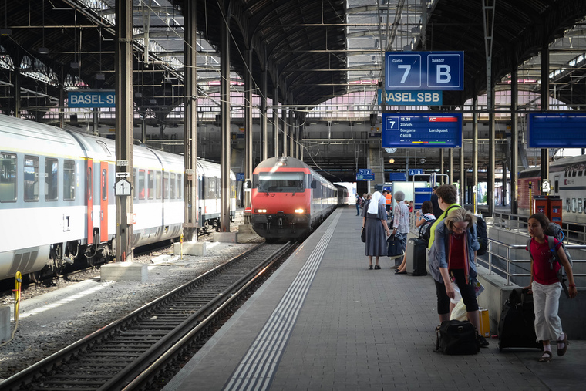
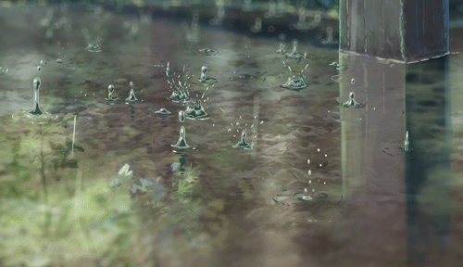


1. It …………………..……….. to rain after we ……………………….………. to the station.
(start / get)
started
had gotten

Slide 28

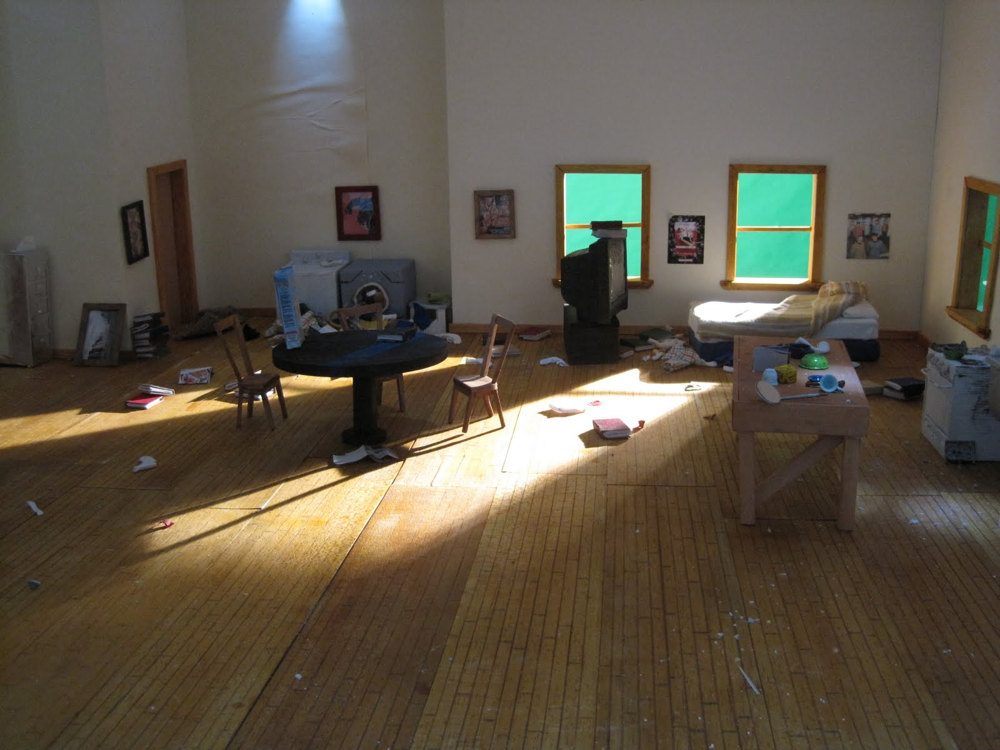
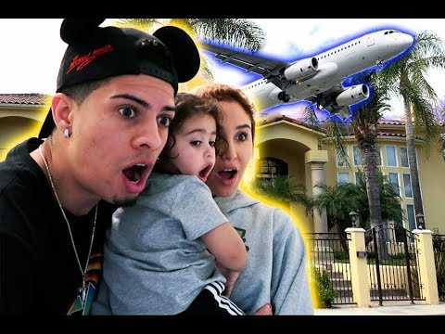
2. By the time we …………………..……….. the party, all the guests ……………………….………..
(reach/ leave)
reached
had left

Slide 29
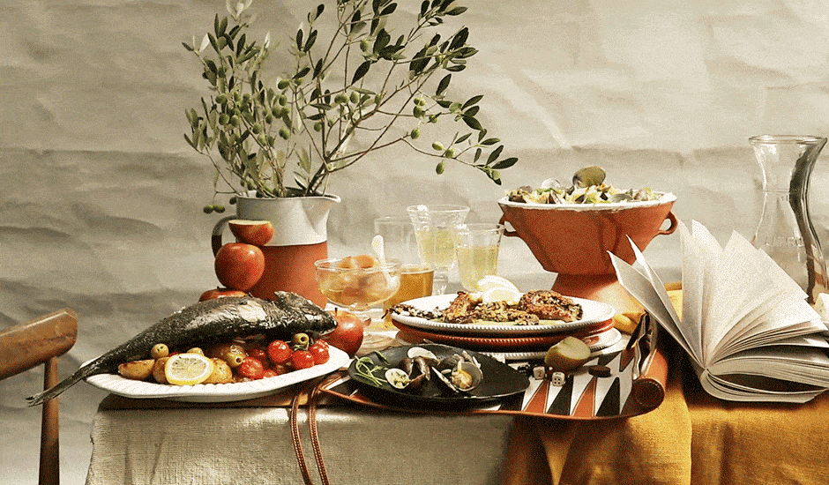
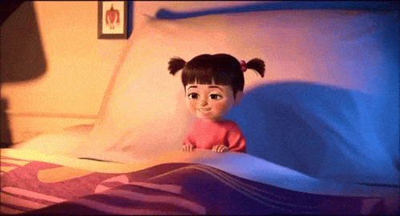
3. Why didn’t you go to bed after you …………………..……….. supper?
(have)
had had

Slide 30
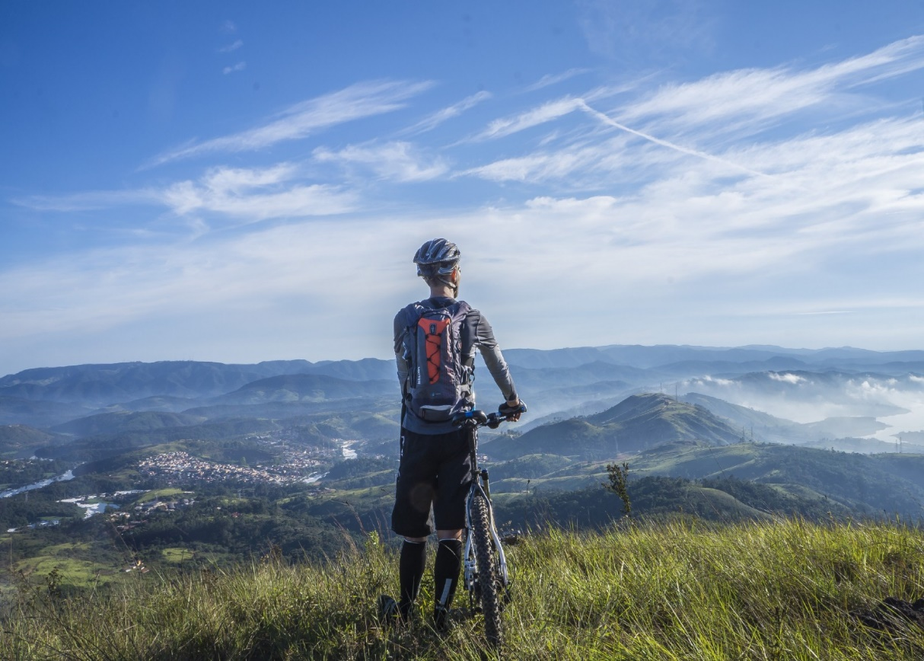
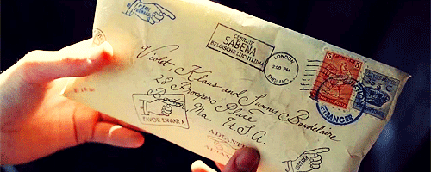
4. Your letter …………………..……….. five minutes after
he ……………………….………..
(come / leave)
came
had left

Slide 31



5. I …………………..……….. my aunt for the flowers she ……………………….………. me.
(thank / send)
thanked
had sent

Slide 32

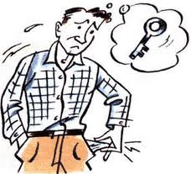
6. Ali couldn’t …………………..……….. the door because he ……………………….………. his keys.
(open / lose)
open
had lost

Slide 33
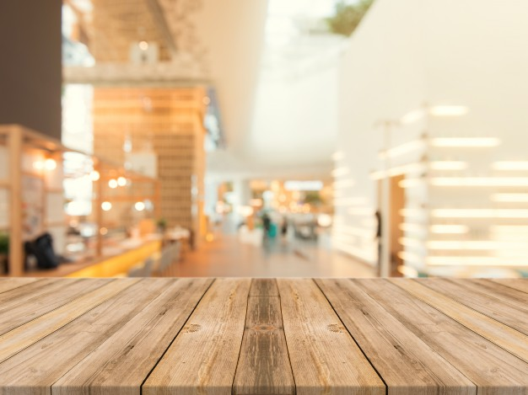

Slide 34

Read your answers.

Slide 35
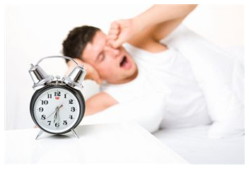
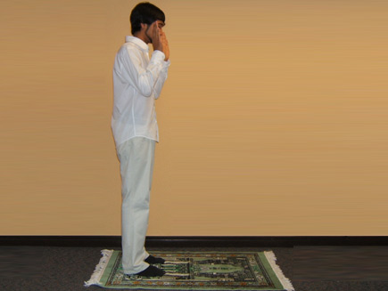
1. After I had woken up, I ……………………….……………
After I had woken up, I had a shower and prayed.

Slide 36
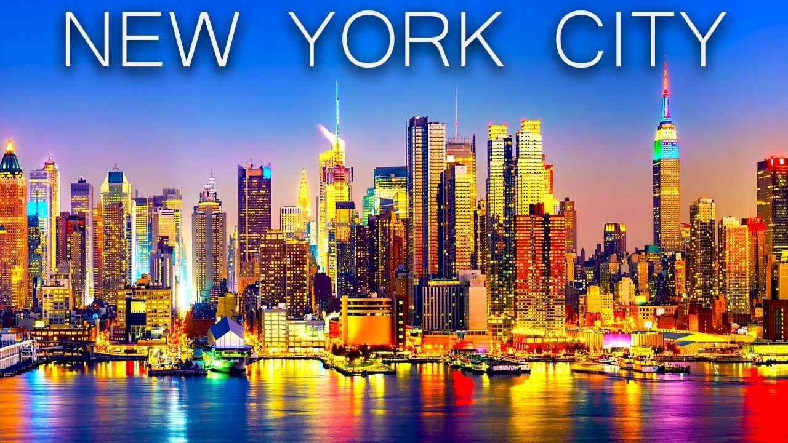
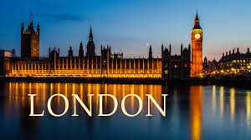
2. I had been in New York before six years before ……………………….……………
I had been in New York before six years before I moved to London.

Slide 37
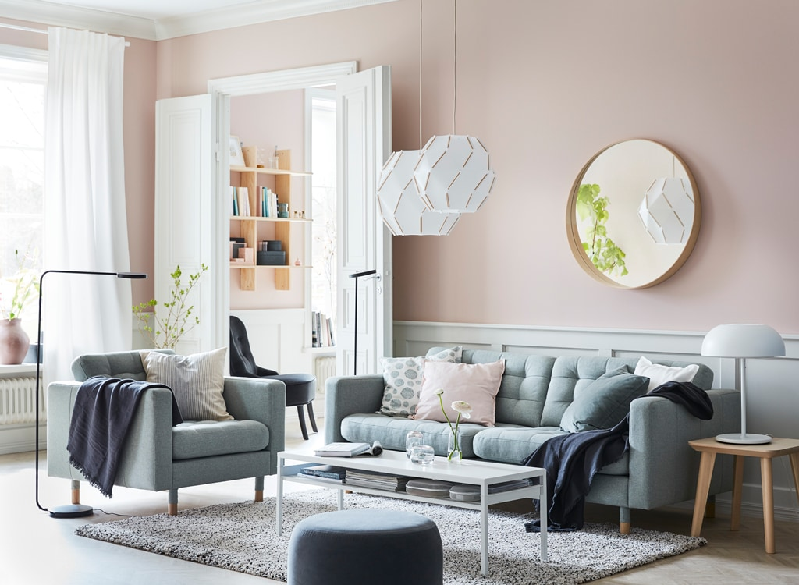
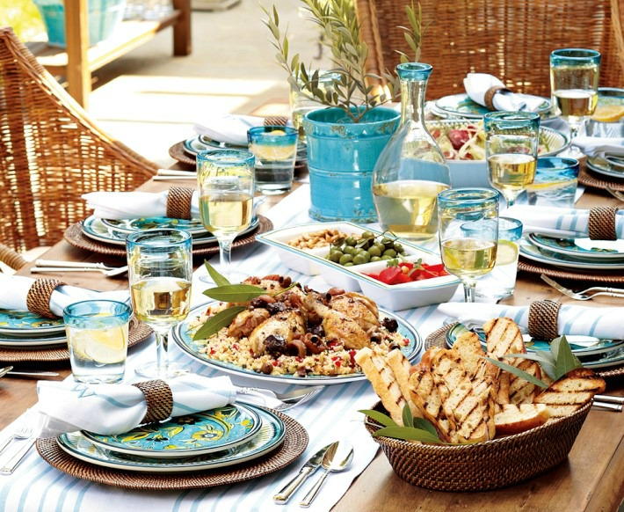
3. By the time we arrived home ………….……………
By the time we arrived home our mother had cooked lunch.

Slide 38
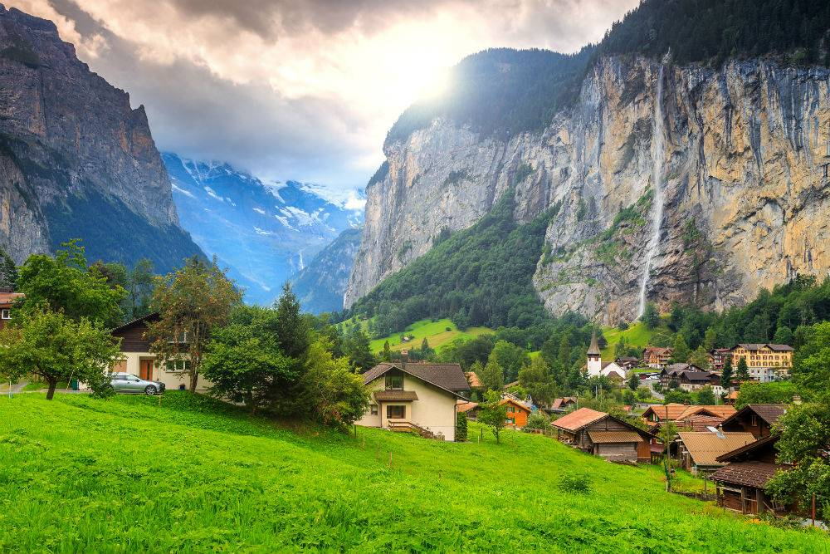
Closure

Slide 39
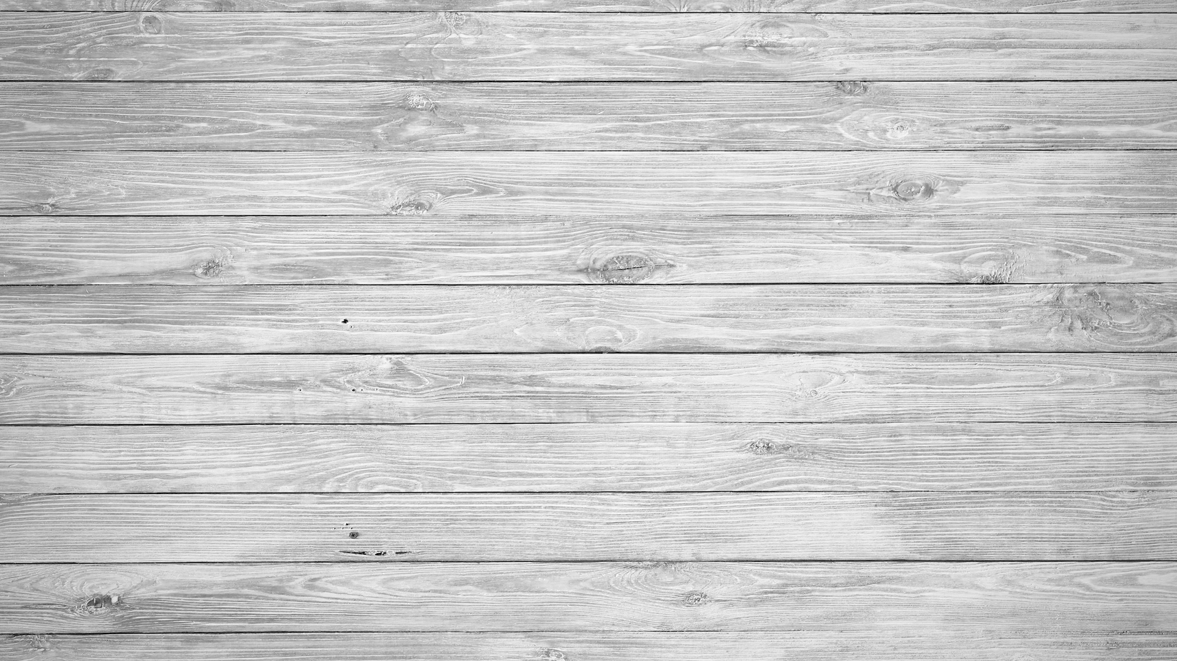
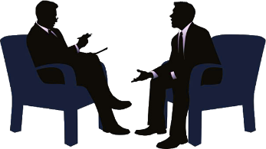

Slide 40
Read your answers.

Slide 41





Slide 42
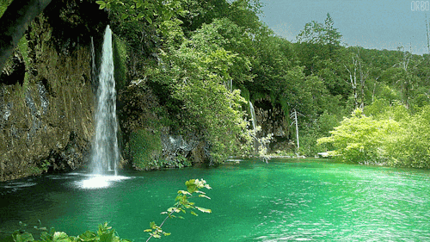
Thank you

